Slide 1
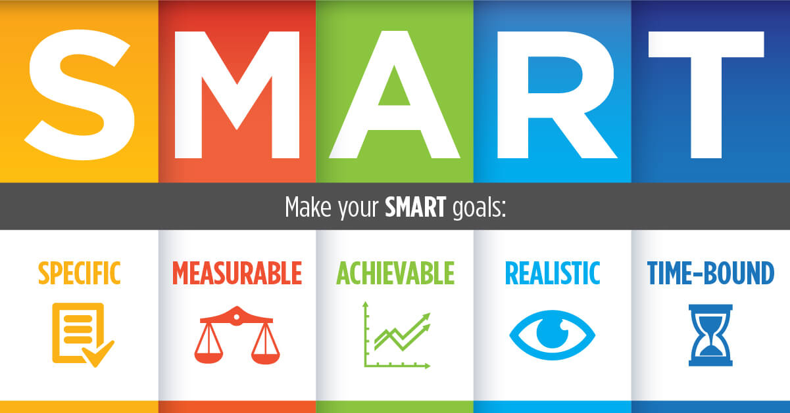
Make your SMART project

Slide 2
Personal Voice Assistant PEPSA
A mini project
By – Ankita Shah

Slide 3
Content
Idea of application
Building Strategy
Programming Language
What this application would do
Guide for its usage

Slide 4
Idea of application
I have built a virtual assistant, also called an AI assistant or digital assistant, that is an application program that understands natural language voice commands and completes tasks for the user.

Slide 5
Building Strategy
The computer needs to be able to recognize our speech.
This is where natural language processing comes in. This is a less complicated form of natural language processing. Basically, NLP is a form of AI that lets the computer take in and store information. Then, analyse that information and relay what it is programmed to do.

Slide 6
Programming Language
We have coded the application in python
Various modules like
speechrecognition,
playsound,
gtts,
os ,
selenium,
pyjokes,
time,
winsound,
random, etc is imported to perform the desired tasks.

Slide 7
What this application would do
The implemented assistant can
open up the application (if installed in system),
search on Google, wikipedia and
YouTube about the query,
answer some specific queries, etc
by just giving the voice command.
We can process the data as per the need or can add the functionality, depending on our requirements.

Slide 8
Guide for its usage
We need any python interpreter like sublime, jupyter notebook, etc
Installation of modules:
pip install <module_name>
Launch anaconda prompt shell :
Run pepsa(file saved as voiceAssistance.py):
python voiceAssistance.py

Slide 9
Features
Fetch result from web
Access YouTube videos
Open and close the specified applications
Open study materials
Play some random songs from list.
Answer Specified queries like Define yourself, why are you created, describe your functionality, etc

Slide 10
THANK YOU
Personal Voice Assistant PEPSA
&
ANKITA SHAH

